Slide 1

26CSE1002J - Programming for Problem Solving
Unit 2 (Modularity)
Session: 1 (SLO 1)
SLO 1 : At the end of this session, the learners will be able to identify when a problem requires decomposition into smaller sub-tasks and select appropriate function types to solve each sub-task.

Slide 2
Learning Outcomes
Learning Outcomes
By the end of the lesson, students will be able to:
Identify problems that can be divided into smaller, manageable sub-tasks.
Break down a complex problem into appropriate functional tasks.
Explain the purpose of functions in solving individual sub-tasks.
Distinguish between the four types of functions based on arguments and return values.
Select the appropriate function type for a given sub-task.
Design and write simple C programs using suitable functions to solve a decomposed problem.
Test and debug functions individually to verify the correctness of the complete program.

Slide 3
DECOMPOSITION
Decomposition breaks a large or complex problem into smaller, simpler sub-tasks.
Instead of writing one large program, we divide the problem into separate functions.
Each function performs one specific task.
A problem should be divided into smaller sub-tasks when:
The problem contains multiple different operations.
The program becomes large or difficult to understand.
The same operation needs to be performed more than once.
Different parts of the problem can be solved independently.
We want the program to be easy to test, debug and maintain.
A task has a clear and well-defined purpose.

Slide 4
DECOMPOSITION
Example
Consider:
Write a program to calculate a rectangle's area and perimeter and display the result.
This can be decomposed into:
Input length and breadth
Calculate area
Calculate perimeter
Display results
The process of dividing the task in to meaningful subtask is called decomposition

Slide 5
Categories or types of functions

Slide 6
There are two main types of functions:
Functions in C
|
-------------------------
| |
Library Functions User-defined Functions
1. Library Functions
These are already provided by C libraries.
Examples:
printf()
scanf()
strlen()
sqrt()
For example:
printf("Hello");
printf() is a library function.
We don't write the code for printf() ourselves.
2. User-defined Functions
These are functions created by the programmer according to the requirement.
Example:
void display()
{
printf("Hello Students");
}
Here, display() is a user-defined function.

Slide 7
Elements of user- defined functions
void welcome()
──── ────────
│ │
│ └── Function Name
│
└── Return Type
()
↑
Parameters
(empty here)
{
printf("Welcome Students");
}
↑ ↑
Start End
of body of body
Example:
void welcome()
{
printf("Welcome Students");
}

Slide 8
1. Function Declaration, Function call and function definition
#include <stdio.h>
void welcome(); // Function declaration
int main()
{
welcome(); // Function call
return 0;
}
void welcome() // Function definition
{
printf("Welcome Students");
}

Slide 9
#include <stdio.h>
void welcome();// declaration
int main()
{
welcome();// function call
return 0;
}
void welcome()// definition
{
printf("Welcome Students\n");
}
1. Calling Function
int main()
main() calls the welcome() function.
So:
main() is called the Calling Function.
2. Called Function
void welcome()
{
printf("Welcome Students\n");
}
welcome() is the function being called by main().
So:
welcome() is called the Called Function.
The function that makes the call → Calling Function
The function that receives the call → Called Function
For example:
Teacher says: "Student, come here."
Teacher → Calling function
Student → Called function

Slide 10
#include <stdio.h>
int main()
{
int result;
result = add(10, 20);
printf("Sum = %d", result);
return 0;
}
int add(int a, int b)
{
return a + b;
}
3. Actual Arguments
Look at:
result = add(10, 20);
The values:
10
20
are called actual arguments.
Why?
Because these are the actual values passed to the function.
Actual arguments are the values given during the function call.

Slide 11
#include <stdio.h>
int main()
{
int result;
result = add(10, 20);
printf("Sum = %d", result);
return 0;
}
int add(int a, int b)
{
return a + b;
}
4. Formal Arguments
Now look at the function definition:
int add(int a, int b)
Here:
a
b
are called formal arguments or formal parameters.
They receive the values from the actual arguments.
So:
Actual arguments Formal arguments
10 ─────────────────→ a
20 ─────────────────→ b
Therefore:
10 → a
20 → b
Then:
return a + b;
becomes:
10 + 20
and returns:
30

Slide 12
Categories of user defined functions

Slide 13
Functions in C
A function is a block of code designed to perform a particular task.
FUNCTION PROTOTYPES :
The functions are classified into the following types depending on the arguments :
Function with no arguments and no return values
Function with arguments and no return values
Function with arguments and with return values
Function with no arguments and with return values

Slide 14
1. FUNCTION WITH NO ARGUMENTS AND NO RETURN VALUES
No data transfer takes place between the calling function and called function.
The called program will not receive any value to the calling program.
The function is only executed and nothing is obtained. They read data values and print result in the same block.
Syntax :
main () func1( ). // dotted line specifies data transfer
{ {
…. …..
…. ……
funct1()
}
} // there is only transfer of control and no data transfer.

Slide 15
Example code for FUNCTION WITH NO ARGUMENTS AND NO RETURN VALUES
#include <stdio.h>
void main()
{
  void add(void);
}
void add()
{
  int a,b,c;
  printf(“enter two numbers “);
  scanf(“%d%d”,&a,&b);
  c=a+b;
  printf( “the sum is %d“,c);
}

Slide 16

2. FUNCTION WITH ARGUMENTS AND NO RETURN VALUES
Data is transferred from calling function to called function.
The called program receives some data from the calling program and does not send back any values to calling program.( one way communication)
This function is partly dependent on the calling function.
Syntax :
main () func1(x,y)
{ {// data transfer→ solid lines
…. …..
func1(a,b)…. ……
} }. // transfer of control → dotted lines

Slide 17
Example: FUNCTION WITH ARGUMENTS AND NO RETURN VALUES
#include <stdio.h>
void add(int,int);
void main()
{
  int a,b;
  printf(“enter two numbers “);
  scanf(“%d%d”, &a,&b);
  add(a,b);
}
void add( int x, int y)
{
  int z;
  z= x+y;
  printf(“the sum is %d“,z );
}

Slide 18


FUNCTION WITH ARGUMENTS AND WITH RETURN VALUES
The data is transferred between the calling function and called function.
The called program receives some data from the calling program and send back a value return to the calling program.(Two way communication) the data transfer takes place between calling and called program.
Syntax :
main () func1(x,y)
{ {
// data transfer→ solid lines
…. …..
func1(a,b)….
……
} return(z);
}.

Slide 19
FUNCTION WITH ARGUMENTS AND WITH RETURN VALUES
#include <stdio.h>
int add(int,int);
void main ()
{
  int a,b,c;
  printf(“enter two numbers “);
  scanf(“%d%d”,&a,&b); // 5 6
  c=add(a,b);
  printf(“the result is %d,c);
  printf(“%d%d,a,b);
}
int add( int x, int y)
{
  int z;
  z= x+y;
  return(z);
}

Slide 20

FUNCTION WITH NO ARGUMENTS AND WITH RETURN VALUES
The calling function will not pass any arguments to the called program, but the called program may send a return value to the calling program. (One-way data communication).
The called function is independent. It reads values from the keyboard or generates them from initialisation and returns the values. Here, both calling and called functions communicate with each other.
Syntax :
main () func1(). // dotted line specifies data transfer
{ {
…. …..
…. ……
C=funct1()
} return(z);
}

Slide 21
FUNCTION WITH NO ARGUMENTS AND WITH RETURN VALUES
#include <stdio.h>
int add();
void main()
{
      c=add();
      printf(“the result is %d“,c);
}
int add( )
{
      int a,b,c;
      printf(“enter two numbers “);
      scanf(“%d%d”,&a,&b);
      c=a+b;
      return(c);
}

Slide 22
Practice Questions
Predict the output before checking the answer.
What is a function in C?
What is a function prototype?
How many types of functions are classified based on arguments and return values?
Name the four types of functions in C.
Which keyword is used for a function that does not return a value?
What is an argument in a function?
What is a return value?
Identify the type of function:
void display()
{
printf("Hello");
}

Slide 23
Practice Answers
A1. A function is a block of statements designed to perform a specific task. A function prototype declares the function name, return type, and parameters before the function is called. Four types. No arguments and no return value
A2. Arguments and no return value
A3. Arguments and return value
A4. No arguments and return value
A5. void
A6. An argument is a value passed from the calling function to the called function.
A7.A return value is the result sent back from the called function to the calling function.
A8. No arguments and no return value

Slide 24
REFERENCE
[1] B. W. Kernighan and D. M. Ritchie, The C Programming Language, 2nd ed., Prentice Hall, 1988.
[2] E. Balagurusamy, Programming in ANSI C, 8th ed., McGraw Hill Education, 2019.
[3] K. N. King, C Programming: A Modern Approach, 2nd ed., W. W. Norton & Company, 2008.
[4] H. Schildt, C: The Complete Reference, 4th ed., McGraw-Hill Education, 2017.
[5] ISO/IEC 9899:2018, Programming Languages — C, ISO, 2018.

Slide 25
26CSE1002J - Programming for Problem Solving
Unit II
Session 2
SLO 1 : At the end of this session the learners will be able to apply pass-by-value and pass-by-reference using functions in C to solve simple mathematical and logical problems.

Slide 26
Learning Outcomes
By the end of the lesson, students will be able to:
Explain the concepts of pass-by-value and pass-by-reference in C.
Differentiate between pass-by-value and pass-by-reference based on how data is passed to functions.
Apply pass-by-value to solve simple mathematical and logical problems.
Use pointers to implement pass-by-reference in C.
Apply pass-by-reference to modify original values and solve problems such as swapping and updating variables.
Develop simple C programs using appropriate parameter-passing techniques.
Test and verify the output of functions using pass-by-value and pass-by-reference.
.

Slide 27
Pass-by-Value and Pass-by-Reference in C
1. Pass-by-Value (call by value)
In pass-by-value, a copy of the value is passed to the function. Changes made inside the function do not affect the original variable.
2. Pass-by-Reference (call by reference)
C does not have a separate pass-by-reference mechanism like some languages. It is commonly implemented by passing the address of a variable using pointers.
Using the address allows the function to modify the original variable.

Slide 28
Pass by value :
Copies the actual parameters into the formal parameters of the function.
The changes in the formal parameters cannot affect the actual parameters.
Because formal arguments are a copy of actual arguments.
Changes made in the formal arguments are local to the block of the called function.
Once control returns to the calling function, the changes made disappear.

Slide 29
Pass by value : Example 1
#include<stdio.h>
int cube(int );
void main()
  {
    int n=5;
    cout<<cube(n); // n is actual argument
  }
int cube(int)
  {
    x=x*x*x; // formal argument
    return(x);
  }

Slide 30
Pass by value : Example 2
    #include <stdio.h>
    void square(int n)
    {
    n = n * n;
    printf("Square = %d\n", n);
    }
    int main()
    {
    int x = 5;
    square(x);
    printf("Original value = %d", x);
    return 0;
    }
    Square = 25
    Original value = 5
    The value 5 is copied into n. Changing n does not change x.

Slide 31
Pass by value: Example 3
#include <stdio.h>
float interest(float p, float r, float t)
{
return (p * r * t) / 100;
}
int main()
{
float p = 5000, r = 5, t = 2;
float result;
result = interest(p, r, t);
printf("Simple Interest = %.2f", result);
return 0;
}
Here the values of p, r, and t are passed to the function.

Slide 32
PASS by reference
Pass by reference is another way of passing parameters to a function.
The addresses of the arguments are copied into the parameters inside the function.
The address is used to access the actual arguments used in the call.
Hence, changes made in the arguments are permanent.
Here, pointers are passed to the function.
Actual parameters :
The parameters transferred from the calling program(main program ) to the called program.
Formal Parameters :
used in the called program (function) to stand for the values that are passed from the main program.

Slide 33
Pass by reference : Example 1
#include <stdio.h>
void interchange(int *a, int *b);
void main()
  {
    int i=5,j=10;
    clrscr();
    printf(”before interchange%d%d”,i,j);
    interchange(&i,&j);
    printf(“after interchange %d%d”,i,j);
    getch();
  }
void interchange(int *a,int *b)
  {
    int t;
    t=*a;
    *a=*b;
    *b=t;
  }

Slide 34
Pass by reference : Example 2
#include <stdio.h>
void swap(int *a, int *b)
{
int temp;
temp = *a;
*a = *b;
*b = temp;
}
int main()
{
int x = 10, y = 20;
printf("Before swap: x = %d, y = %d\n", x, y);
swap(&x, &y);
printf("After swap: x = %d, y = %d\n", x, y);
return 0;
}
output :
Before swap: x = 10, y = 20
After swap: x = 20, y = 10
passes the addresses of x and y.

Slide 35
Pass by reference : Example 3
#include <stdio.h>
void findValues(int a, int b, int *largest, int *smallest)
{
if (a > b)
{
*largest = a;
*smallest = b;
}
else
{
*largest = b;
*smallest = a;
}
}
int main()
{
int a = 15, b = 25;
int large, small;
findValues(a, b, &large, &small);
printf("Largest = %d\n", large);
printf("Smallest = %d", small);
return 0;
}
output :
Largest = 25
Smallest = 15

Slide 36
Difference Between Pass-by-Value and Pass-by-Reference
Pass-by-Value | Pass-by-Reference
Copy of value is passed | Address is passed
Uses normal parameters | Uses pointer parameters
Original variable is not changed | Original variable can be changed
Example: square(x) | Example: swap(&x, &y)
.
Pass-by-value:
value → function
Pass-by-reference:
address → function → original value can change

Slide 37
Pass By reference: Example 1
#include <stdio.h>
void change(int *n)
{
*n = 100;
}
int main()
{
int x = 20;
printf("Before = %d\n", x);
change(&x);
printf("After = %d\n", x);
return 0;
}
output :
Before = 20
After = 100
this is achieved by passing addresses using pointers. The function can then modify the original variables.

Slide 38
pass by reference : Example 2
#include <stdio.h>
void calculate(int a, int b, int *sum, int *diff)
{
*sum = a + b;
*diff = a - b;
}
int main()
{
int x = 20, y = 8;
int sum, diff;
calculate(x, y, &sum, &diff);
printf("Sum = %d\n", sum);
printf("Difference = %d\n", diff);
return 0;
}
output :
Sum = 28
Difference = 12
The function modifies sum and diff through their addresses.

Slide 39
Practice Questions with Answers
Q1. What will be the output?
#include <stdio.h>
void change(int x)
{
x = 20;
}
int main()
{
int a = 10;
change(a);
printf("%d", a);
return 0;
}
Answer
10
Reason: In pass-by-value, only a copy of a is passed to x. So the original a remains unchanged.

Slide 40
Practice Questions with Answers
Q2. What will be the output?
#include <stdio.h>
void change(int *x)
{
*x = 20;
}
int main()
{
int a = 10;
change(&a);
printf("%d", a);
return 0;
}
Answer
20
Reason: The address of a is passed, so the function changes the original value.

Slide 41
Practice Questions with Answers
Q3. Write a C program to add two numbers using pass-by-value.
Answer
#include <stdio.h>
int add(int a, int b)
{
return a + b;
}
int main()
{
int x = 10, y = 20;
printf("Sum = %d", add(x, y));
return 0;
}
Output:
Sum = 30

Slide 42
Practice Questions with Answers
Q4. Write a C program to double a number using pass-by-value.
Answer
#include <stdio.h>
int doubleValue(int n)
{
return n * 2;
}
int main()
{
int n = 5;
printf("Result = %d", doubleValue(n));
return 0;
}
Output:
Result = 10

Slide 43
Practice Questions with Answers
Q5. Write a C program to increase a number by 5 using pass-by-reference.
Answer
#include <stdio.h>
void increase(int *n)
{
*n = *n + 5;
}
int main()
{
int n = 10;
increase(&n);
printf("Result = %d", n);
return 0;
}
Output:
Result = 15

Slide 44
REFERENCE
Brian W. Kernighan and Dennis M. Ritchie, The C Programming Language, 2nd Edition, Prentice Hall, 1988.
Yashavant Kanetkar, Let Us C, BPB Publications.
Herbert Schildt, C: The Complete Reference, McGraw-Hill Education.
GNU Project, GNU C Reference Manual.
cppreference, C Language – Functions.

Slide 45
26CSE1002J - Programming for Problem Solving
Unit II
Session 3
SLO 1 : At the end of this session, the learners will be able to ecompose a complex problem, such as calculating a student’s scorecard, into smaller tasks for calculating the total, average, and grade, and organize each task using appropriate functions in C.

Slide 46
Learning Outcomes
By the end of the lesson, students will be able to:
Identify the different tasks involved in calculating a student’s scorecard.
Decompose a complex problem into smaller and manageable sub-tasks.
Determine the input and output required for each sub-task.
Design separate functions for calculating total, average, and grade.
Select appropriate function types for each sub-task.
Develop a modular C program for calculating and displaying a student’s scorecard.
Test and verify the correctness of each function and the overall program.

Slide 47
Guided Practice: Prime Number Using Helper Functions
Problem Statement
Break a complex problem (“calculate the scorecard of a student: total, average, grade”) into smaller tasks.
Break the problem into smaller tasks.
The complete problem can be divided into:
Student Scorecard
Read marks
Calculate Total
Calculate Average
Calculate Grade
Display Scorecard
Each task can be performed by a separate function.

Slide 48
Create functions for each task
We can use:
readMarks() → read the marks
calculateTotal() → calculate total
calculateAverage()→ calculate average
calculateGrade() → find grade
displayScorecard()→ display the result
This makes the program easier to understand and maintain.

Slide 49
complete c program
#include <stdio.h>
void readMarks(int marks[], int n)
{
int i;
printf("Enter marks for %d subjects:\n", n);
for(i = 0; i < n; i++)
{
scanf("%d", &marks[i]);
}
}
int calculateTotal(int marks[], int n)
{
int i, total = 0;
for(i = 0; i < n; i++)
{
total = total + marks[i];
}
return total;
}
float calculateAverage(int total, int n)
{
return (float)total / n;
}
char calculateGrade(float average)
{
if(average >= 90)
return 'A';
else if(average >= 75)
return 'B';
else if(average >= 60)
return 'C';
else if(average >= 50)
return 'D';
else
return 'F';
}
void displayScorecard(int total, float average, char grade)
{
printf("\n--- Student Scorecard ---\n");
printf("Total = %d\n", total);
printf("Average = %.2f\n", average);
printf("Grade = %c\n", grade);
}
int main()
{
int marks[5];
int total;
float average;
char grade;
readMarks(marks, 5);
total = calculateTotal(marks, 5);
average = calculateAverage(total, 5);
grade = calculateGrade(average);
displayScorecard(total, average, grade);
return 0;
}

Slide 50
Understand the decomposition
1. readMarks()
void readMarks(int marks[], int n)
Task: Gets the marks of the student.
It does not return a value, so the return type is void.
2. calculateTotal()
int calculateTotal(int marks[], int n)
Task: Adds all the marks.
It receives the marks as arguments and returns the total.
So:
Arguments + Return value

Slide 51
Understand the decomposition
3. calculateAverage()
float calculateAverage(int total, int n)
Task: Calculates:
Average = Total / Number of subjects
It receives total and n, and returns the average.
Again:
Arguments + Return value
4. calculateGrade()
char calculateGrade(float average)
Task: Decides the grade based on the average.
For example:
90 and above → A 75–89 → B 60–74 → C 50–59 → D Below 50 → F
It receives the average and returns a character.
Arguments + Return value
5. displayScorecard()
void displayScorecard(int total, float average, char grade)
Task: Displays the final scorecard.
It receives values but does not return anything.
Arguments + No return value

Slide 52
PrOGRAM FLOW - The main() function now becomes very simple:
main()
↓
readMarks()
↓
calculateTotal()
↓
calculateAverage()
↓
calculateGrade()
↓
displayScorecard()
For example,
suppose the marks are:
80 70 90 85 75
Then:
Total = 400
Average = 80
Grade = B

Slide 53
Why is this called decomposition?
The original problem:
Calculate a student's scorecard
is a complex problem because it involves several operations.
We decompose it into:
Read marks
↓
Find total
↓
Find average
↓
Find grade
↓
Display result
Each smaller task is handled by a function.

Slide 54
The main idea
Large problem → Smaller tasks → Functions → Complete solution
This is exactly how decomposition makes a program modular and easier to understand.
Task | Function | Function Type
Read marks | readMarks() | Arguments + No return value
Calculate total | calculateTotal() | Arguments + Return value
Calculate average | calculateAverage() | Arguments + Return value
Calculate grade | calculateGrade() | Arguments + Return value
Display scorecard | displayScorecard() | Arguments + No return value
Decomposition is the process of breaking a complex problem into smaller sub-tasks. In the student scorecard problem, the tasks of reading marks, calculating the total, calculating the average, finding the grade, and displaying the result are implemented using separate functions. This makes the program easier to understand, test, debug, and maintain.

Slide 55
REFERENCE
Brian W. Kernighan and Dennis M. Ritchie, The C Programming Language, 2nd Edition, Prentice Hall, 1988.
Yashavant Kanetkar, Let Us C, BPB Publications.
Herbert Schildt, C: The Complete Reference, McGraw-Hill Education.
GNU Project, GNU C Reference Manual.
cppreference, C Language – Functions.

Slide 56
26CSE1002J - Programming for Problem Solving
Unit II
Session 4
SLO:At the end of this session, the learners will be able to decompose the problem into smaller sub-tasks and design a C function using pass-by-value to compute the sum of the first n even numbers.

Slide 57
Learning Outcomes
By the end of the lesson, students will be able to:
Explain the concept of pass-by-value in C.
Identify the sub-tasks involved in finding the sum of the first n even numbers.
Decompose the problem into smaller and manageable tasks.
Design a function that accepts n as a parameter and computes the required sum.
Apply pass-by-value to pass the value of n to the function.
Implement the solution using a loop and appropriate C syntax.
Test and verify the function using different values of n.

Slide 58
Using pass-by-value, design a function to compute the sum of the first n even numbers by breaking the problem into sub-tasks.
Step 1: Break the problem into smaller tasks
The problem can be divided into:
Find the sum of the first n even numbers
Read n
Generate even numbers
Calculate sum
Display result
For the calculation, we can create a function that receives n by value.

Slide 59
Step 2: Understand the first n even numbers
The even numbers are:
2, 4, 6, 8, 10, ...
For n = 5:
2 + 4 + 6 + 8 + 10 = 30
The ith even number can be obtained using:
2 * i

Slide 60
Step 3: C Program Using
Pass-by-Value
#include <stdio.h>
int sumEven(int n)
{
int i;
int sum = 0;
for(i = 1; i <= n; i++)
{
sum = sum + (2 * i);
}
return sum;
}
int main()
{
int n, result;
printf("Enter the number of even numbers: ");
scanf("%d", &n);
result = sumEven(n);
printf("Sum of first %d even numbers = %d", n, result);
return 0;
}

Slide 61
Example :
Input:
5
Calculation:
2 + 4 + 6 + 8 + 10 = 30
Output:
Sum of first 5 even numbers = 30

Slide 62
How is this pass-by-value?
result = sumEven(n);
The function copies the value of n into its parameter n.
    main()
    n
    ↓
    sumEven(n)
    ↓
    calculate sum
    ↓
    return result
The function does not modify the original n.

Slide 63
Decomposition Used
Sub-task | Code
Read n | scanf() in main()
Generate even numbers | 2 * i
Calculate sum | sumEven()
Return answer | return sum
Display result | printf() in main()
The problem breaks down into smaller tasks: read the value of n, generate the first n even numbers, calculate their sum, and display the result. The sumEven() function receives n by value, calculates the sum, and returns the result to the calling function.

Slide 64
Practice 1: Employee Salary Analysis
Example: Calculate an Employee Salary
Problem :
Calculate the salary of an employee: Basic Salary, HRA, DA and Gross Salary.
Decompose the problem into smaller tasks :
Calculate Employee Salary
|
basic salary
|
Calculate HRA
|
Calculate DA
|
Calculate Gross Salary
|
Display salary details

Slide 65
readSalary()
↓ calculateHRA()
↓ calculateDA()
↓ calculateGrossSalary()
↓ displaySalary()

Slide 66
Example values
Suppose:
Basic Salary = ₹30,000 HRA = 20% of Basic = ₹6,000 DA = 10% of Basic = ₹3,000
Therefore:
Gross Salary = 30,000 + 6,000 + 3,000 = ₹39,000

Slide 67
#include <stdio.h>
float calculateHRA(float basic)
{
return basic * 0.20;
}
float calculateDA(float basic)
{
return basic * 0.10;
}
float calculateGross(float basic, float hra, float da)
{
return basic + hra + da;
}
void displaySalary(float basic, float hra, float da, float gross)
{
printf("Basic Salary = %.2f\n", basic);
printf("HRA = %.2f\n", hra);
printf("DA = %.2f\n", da);
printf("Gross Salary = %.2f\n", gross);
}
int main()
{
float basic, hra, da, gross;
printf("Enter basic salary: ");
scanf("%f", &basic);
hra = calculateHRA(basic);
da = calculateDA(basic);
gross = calculateGross(basic, hra, da);
displaySalary(basic, hra, da, gross);
return 0;
}

Slide 68
Decomposition idea :
Large problem → smaller tasks → separate functions → final solution
This example also shows how to select different function types depending on whether a function needs arguments and whether it needs to return a value.

Slide 69
Practice Questions – Decomposition Using Functions in C
Questions
1. Student Scorecard
Break the problem “Calculate the scorecard of a student: total, average and grade” into smaller sub-tasks and identify suitable functions for each task.
2. Electricity Bill
Break the problem “Calculate an electricity bill based on units consumed” into smaller functions.
3. Simple Calculator
Break the problem “Perform addition, subtraction, multiplication and division of two numbers” into smaller sub-tasks.

Slide 70
1. Student Scorecard
Student Scorecard
|
Read marks
|
Calculate total
|
Calculate average
|
Calculate grade
|
Display scorecard
Functions:
readMarks()
calculateTotal()
calculateAverage()
calculateGrade()
displayScorecard()

Slide 71
2. Electricity Bill
Electricity Bill
|
Read units consumed
|
Calculate bill amount
|
Add additional charges, if any
|
Display bill
Functions:
readUnits()
calculateBill()
calculateCharges()
displayBill()

Slide 72
3. Simple Calculator
|
Read two numbers
|
Add numbers
|
Subtract numbers
|
Multiply numbers
|
Divide numbers
|
Display result
Functions:
add()
subtract()
multiply()
divide()
displayResult()

Slide 73
REFERENCE
[1] B. W. Kernighan and D. M. Ritchie, The C Programming Language, 2nd Ed., Prentice Hall, 1988.
[2] Y. Kanetkar, Let Us C, BPB Publications.
[3] H. Schildt, C: The Complete Reference, McGraw-Hill Education.
[4] GNU Project, GNU C Language Manual.
[5] cppreference, C Language – Functions.

Slide 74
26CSE1002J - Programming for Problem Solving
Unit 2 (Modularity)
Session: 5 (SLO 1)
SLO :At the end of this session the learners will be able to Explain pointer concepts and apply pointer variables to access and manipulate memory in C programs.

Slide 75
POINTERS IN C
A special variable that stores the memory address of another variable instead of storing a direct value.
Used to Accessing and Manipulating Memory Using Pointer Variables.
They are the backbone of low-level memory manipulation, dynamic allocation, and efficient data handling in C programming
10
&x
*p
1000
1001
1002
Address: F7F9FC
Address: F7F9FC
Address: F7F9FC

Slide 76
Why Do We Need Pointers?
Efficient arrays
Functions
Dynamic memory
Traverse and manipulate arrays without copying data.
Pass addresses so functions can modify original variables.
Work with memory allocated using malloc(), calloc() and realloc().
Data structures
Low-level control
Build linked lists, trees, graphs and other dynamic structures.
Useful in systems programming, buffers and hardware-oriented code.

Slide 77
Understanding Memory & Addresses
Every variable occupies a location in memory.
Address
Pointer
x
&x gives the address
A memory location can be represented by an address such as 1000.
A pointer stores that address so the program can reach the memory location.
10
Address: 1000
Variable
int x = 10;
printf("%p", (void*)&x);

Slide 78
What Is a Pointer?
A pointer is a variable that stores the address of another variable.
int x = 10;
int *p;
p = &x;
x
10
Address: 1000
p points to x
p
1000
Key idea:
p contains the address of x.
*p accesses the value stored at that address.
Address: 2000

Slide 79
The & and * Operators
& — Address-of
* — Dereference
&x means: obtain the memory address of x.
Example: p = &x;
*p means: access the value stored at the address contained in p.
Example: printf("%d", *p);
For int x = 10; int *p = &x;
x → 10 &x → address of x p → address of x *p → 10

Slide 80
Basic Pointer Program
#include <stdio.h>
int main()
{
int x = 10;
int *p = &x;
printf("x = %d\n", x);
printf("&x = %p\n", (void*)&x);
printf("p = %p\n", (void*)p);
printf("*p = %d\n", *p);
return 0;
}
Expected relationship
p and &x contain the same address.
Dereference
*p gives the value stored at x.
Note
Use %p for addresses.

Slide 81
Solved examples:
1. changing a value through a pointer
#include <stdio.h>
int main(void)
{
int a = 10;
int *p = &a;
*p = 25;
printf("a = %d\n", a);
printf("*p = %d\n", *p);
return 0;
}
Output:
a = 25
*p = 25
Statement | Effect
int a = 10; | a becomes 10
int *p = &a; | p points to a
*p = 25; | The integer pointed to by p, which is a, becomes 25

Slide 82
Solved examples:
2. Displaying value through a pointer
#include <stdio.h>
int main(void)
{
int a = 10;
int *ptr;
ptr = &a;
printf("Value of a = %d\n", a);
printf("Value of a = %d\n", *ptr);
printf("Value of a = %d\n", *(&a));
printf("Value of a = %d\n", *(*(&ptr)));
printf("Address of a = %p\n", (void *)&a);
printf("Address of a = %p\n", (void *)ptr);
printf("Address of a = %p\n", (void *)*(&ptr));
return 0;
}

Slide 83
Solved example:
3. calculation through a pointer
Output:
15
#include <stdio.h>
int main(void)
{
int a = 10;
int *p = &a;
*p = *p + 5;
printf("%d\n", a);
return 0;
}
Right side: read *p, which is 10, and calculate 10 + 5.
Left side: store the result in the integer that p points to.
For this particular pointer:
*p = *p + 5;
has the same effect as:
a = a + 5;

Slide 84
Solved example:
3. changing where a pointer points
#include <stdio.h>
int main(void)
{
int a = 10;
int b = 20;
int *p = &a;
printf("%d\n", *p);
p = &b;
*p = 50;
printf("a = %d\n", a);
printf("b = %d\n", b);
return 0;
}
Output:
10
a = 10
b = 50
Statement | What p points to | a | b
int *p = &a; | a | 10 | 20
p = &b; | b | 10 | 20
*p = 50; | b | 10 | 50

Slide 85
Solved example:
4. pointer to pointer
#include <stdio.h>
int main(void)
{
int a = 10;
int *ptr1;
int **ptr2;
int ***ptr3;
ptr1 = &a;
ptr2 = &ptr1;
ptr3 = &ptr2;
printf("Value of a = %d\n", a);
printf("Value of a = %d\n", *ptr1);
printf("Value of a = %d\n", **ptr2);
printf("Value of a = %d\n", ***ptr3);
return 0;
}

Slide 86
Connect pointers to their previous lesson on functions
#include <stdio.h>
void change(int x)
{
x = 100;
}
int main(void)
{
int a = 10;
change(a);
printf("a = %d\n", a);
return 0;
}
Output:
a = 10
The function received a copy of the value of a. Its parameter x is a separate variable
Trace:
Stage | a in main() | x in change()
Function begins | 10 | 10
After x = 100 | 10 | 100
After function returns | 10 | No longer available

Slide 87
Pointer Arithmetic
Pointers can move through adjacent elements of the same data type.
int a[3] = {10,20,30};
int *p = a;
p++;
a[0]
a[1]
a[2]
10
20
30
Address: 1000
Address: 1001
Address: 1002
p++ moves to the next int element.
Common forms: p++ p-- p + i p - i
Important: the step size depends on the pointer's data type.

Slide 88
Pointers and Arrays
Array indexing and pointer arithmetic are closely related.
int a[5] = {10,20,30,40,50};
int *p = a;
for (int i = 0; i < 5; i++)
printf("%d ", *(p+i));
Key relationship
a[i] == *(a + i)
Pointer traversal
p = a; then *(p+i) accesses each element.
Output: 10 20 30 40 50

Slide 89
Pointers and Functions
Passing an address lets a function modify the caller's variable
void change(int *x)
{
*x = 100;
}
int main()
{
int a = 10;
change(&a);
printf("%d", a);
}
a
10
Address: 1000
change(&a)
Inside function: *x = 100
Therefore a becomes 100.

Slide 90
Application: Swapping Two Numbers
void swap(int *a, int *b)
{
int temp = *a;
*a = *b;
*b = temp;
}
int x=10, y=20;
swap(&x, &y);
x
10
Address: 1000
after swap
y
20
Address: 1004
x = 20, y = 10

Slide 91
Pointer to Pointer
q
A pointer can store the address of another pointer.
stores address of p
q → p → x
*q → address in p
**q → value in x = 10
int x = 10;
int *p = &x;
int **q = &p;
printf("%d", **q);
p
stores address of x
x
stores 10

Slide 92
NULL Pointer & Common Errors
Safe pointer use is as important as pointer syntax.
NULL pointer
Uninitialized pointer
Dangling pointer
int *p = NULL;
Check p before dereferencing.
int *p;
Do not dereference until p points to valid storage.
A pointer referring to memory that is no longer valid.
if (p != NULL)
printf("%d", *p);
Rule: Never dereference an invalid or NULL pointer.

Slide 93
Practice Questions
Predict the output before checking the answer.
Q1. int x=10; int *p=&x; printf("%d", *p);
Q2. int x=10; int *p=&x; *p=25; printf("%d", x);
Q3. int a[]={10,20,30}; int *p=a; printf("%d", *(p+2));
Q4. What does &x return?
Q5. What does *p return when p points to x?

Slide 94
Practice Answers
A1. 10
A2. 25
A3. 30
A4. The memory address of x.
A5. The value stored at the address contained in p.
Key rule: & gives an address; * accesses the value at an address.

Slide 95
REFERENCE
[1] B. W. Kernighan and D. M. Ritchie, The C Programming Language, 2nd ed., Prentice Hall, 1988.
[2] E. Balagurusamy, Programming in ANSI C, 8th ed., McGraw Hill Education, 2019.
[3] K. N. King, C Programming: A Modern Approach, 2nd ed., W. W. Norton & Company, 2008.
[4] H. Schildt, C: The Complete Reference, 4th ed., McGraw-Hill Education, 2017.
[5] ISO/IEC 9899:2018, Programming Languages — C, ISO, 2018.

Slide 96
26CSE1002J - Programming for Problem Solving
Unit II
Session6
SLO 1 :At the end of this session the learners will be able to Design helper functions to modularize complex problems and improve clarity of the solution approach. Design and implement functions with return values in C.

Slide 97
Learning Outcomes
Identify complex tasks within a programming problem.
Break a large problem into smaller modules.
Design suitable helper functions.
Select appropriate parameters and return types.
Implement functions that return values.
Call and integrate multiple functions in main().
Test individual functions and the complete program.
Apply modular programming to real-world problems.

Slide 98
Why Do We Need Functions?
To modularize complex problems and improve clarity, the functions can be designed that follow the Single Responsibility Principle—each function does exactly one job, does it well, and returns a clear result.
Example: Student result processing
• Calculate total marks
• Calculate average
• Calculate percentage
• Calculate grade
• Determine pass/fail
Without functions:
main() → Input → All calculations → Display
Problems:
• Long code
• Difficult debugging
• Repeated logic
• Poor readability
Solution: Divide the problem into smaller functions.

Slide 99
What is Modular Programming?
Modular programming means breaking a large problem into small, independent modules/functions.
Student Result
├── calculateTotal()
├── calculateAverage()
├── calculateGrade()
└── displayResult()
Advantages:
• Improves readability
• Simplifies debugging
• Promotes code reuse
• Reduces complexity
• Makes testing easier

Slide 100
Anatomy of a Function
General Syntax
return_type function_name(parameters)
{
statements;
return value;
}
Example
int add(int a, int b)
{
int sum;
sum = a + b;
return sum;
}
Components
Component | Meaning
int | Return type
add | Function name
a, b | Parameters
sum | Local variable
return sum | Returned result

Slide 101
Function Declaration, Definition and Call
A function generally involves three important parts.
1. Function Declaration
int add(int, int);
2. Function Definition
int add(int a, int b)
{
return a + b;
}
3. Function Call
result = add(10, 20);
Execution:
main()
add(10,20)
add()
10+20
return 30
result=30

Slide 102
Parameters, Arguments and Return Value
int multiply(int a, int b)
{
return a * b;
}
Calling: result = multiply(5, 4);
Parameters:
a and b → Variables defined in the function.
Arguments:
5 and 4 → Actual values passed during the function call.
Return value:
20 → The result sent back to the calling function.

Slide 103
Function with Return Value: Example
Problem
Write a function to calculate the square of a number.
#include <stdio.h>
int square(int n)
{
return n * n;
}
int main()
{
int num, result;
printf("Enter a number: ");
scanf("%d", &num);
result = square(num);
printf("Square = %d", result);
return 0;
}
Sample Output
Enter a number: 6
Square = 36
Key Idea
The function calculates and returns the answer.

Slide 104
Designing Helper Functions
Problem
Find the largest of three numbers.
Instead of writing all logic in main(), identify the specific task.
Step 1 – Identify the task
Find Largest
Step 2 – Create a helper function
int findLargest(int a, int b, int c)
Step 3 – Return the result
return largest;
Step 4 – Call from main()
largest = findLargest(a, b, c);

Slide 105
Example: Largest of Three Numbers
#include <stdio.h>
int findLargest(int a, int b, int c)
{
if (a >= b && a >= c)
return a;
else if (b >= c)
return b;
else
return c;
}
int main()
{
int a, b, c, largest;
printf("Enter three numbers: ");
scanf("%d %d %d", &a, &b, &c);
largest = findLargest(a, b, c);
printf("Largest = %d", largest);
return 0;
}

Slide 106
Practice Questions with Answers
Q1. Write a function square() that accepts an integer and returns its square.
Answer:
int square(int n)
{
return n * n;
}
Function call:
printf("Square = %d", square(5));
Output:
Square = 25

Slide 107
Practice Questions with Answers
Q2. Write a function cube() that returns the cube of a number.
Answer:
int cube(int n)
{
return n * n * n;
}
Function call:
printf("Cube = %d", cube(3));
Output:
Cube = 27

Slide 108
Practice Questions with Answers
Q3. Write a function to find the maximum of two numbers.
Answer:
int maximum(int a, int b)
{
if (a > b)
return a;
else
return b;
}
Function call:
printf("Maximum = %d", maximum(25, 18));
Output:
Maximum = 25

Slide 109
Practice Questions with Answers
Q4. Write a function isEven() that returns 1 if a number is even and 0 otherwise.
Answer:
int isEven(int n)
{
if (n % 2 == 0)
return 1;
else
return 0;
}
Function call:
if (isEven(12))
printf("Even");
else
printf("Odd");
Output:
Even

Slide 110
Practice Questions with Answers
Q5. Write a function to calculate the factorial of a number.
Answer:
int factorial(int n)
{
int i, fact = 1;
for (i = 1; i <= n; i++)
fact = fact * i;
return fact;
}
Function call:
printf("Factorial = %d", factorial(5));
Output:
Factorial = 120

Slide 111
Practice Questions with Answers
Q6. Write a function to calculate the area of a circle.
Answer:
float calculateArea(float radius)
{
return 3.14 * radius * radius;
}
Function call:
printf("Area = %.2f", calculateArea(5));
Output:
Area = 78.50

Slide 112
Practice Questions with Answers
Q7. Write a function to determine whether a year is a leap year.
Answer:
int isLeapYear(int year)
{
if ((year % 400 == 0) ||
(year % 4 == 0 && year % 100 != 0))
return 1;
else
return 0;
}
Function call:
if (isLeapYear(2024))
printf("Leap Year");
else
printf("Not a Leap Year");
Output:
Leap Year

Slide 113
Practice Questions with Answers
Q8. Write a function to calculate the sum of three numbers.
Answer:
int calculateSum(int a, int b, int c)
{
return a + b + c;
}
Function call:
printf("Sum = %d", calculateSum(10, 20, 30));
Output:
Sum = 60

Slide 114
Practice Questions with Answers
Q9. Design helper functions to calculate the total and average of three marks.
Answer:
#include <stdio.h>
int calculateTotal(int m1, int m2, int m3)
{
return m1 + m2 + m3;
}
float calculateAverage(int total)
{
return total / 3.0;
}
int main()
{
int total;
float average;
total = calculateTotal(80, 75, 90);
average = calculateAverage(total);
printf("Total = %d\n", total);
printf("Average = %.2f", average);
return 0;
}
Output:
Total = 245
Average = 81.67

Slide 115
Practice Questions with Answers
Q10. Design a modular program to calculate a student's grade.
Requirement:
Calculate total
Calculate average
Determine grade
Answer:
#include <stdio.h>
int calculateTotal(int m1, int m2, int m3)
{ return m1 + m2 + m3; }
float calculateAverage(int total)
{ return total / 3.0; }
char findGrade(float average)
{ if (average >= 90)
return 'A';
else if (average >= 75)
return 'B';
else if (average >= 60)
return 'C';
else if (average >= 50)
return 'D';
else
return 'F’; }
int main()
{ int total;
float average;
char grade;
total = calculateTotal(85, 78, 92);
average = calculateAverage(total);
grade = findGrade(average);
printf("Total = %d\n", total);
printf("Average = %.2f\n", average);
printf("Grade = %c\n", grade);
return 0; }
Output:
Total = 255
Average = 85.00
Grade = B

Slide 116
Practice Questions
Q11. Design helper functions for an electricity bill.
Problem:
Write a program that calculates an electricity bill based on units consumed.
Use:
First 100 units → ₹2/unit
Next 100 units → ₹3/unit
Above 200 units → ₹5/unit

Slide 117
Answer:
#include <stdio.h>
float calculateBill(int units)
{
float bill;
if (units <= 100)
bill = units * 2;
else if (units <= 200)
bill = 100 * 2 + (units - 100) * 3;
else
bill = 100 * 2 + 100 * 3 + (units - 200) * 5;
return bill;
}
int main()
{
int units = 250;
float bill;
bill = calculateBill(units);
printf("Units = %d\n", units);
printf("Bill = Rs. %.2f", bill);
return 0;
}
Output:
Units = 250
Bill = Rs. 850.00

Slide 118
Practice Questions
Q12. Design a modular calculator using helper functions.
Problem:
Create separate functions for:
Addition
Subtraction
Multiplication
Division

Slide 119
Answer:
#include <stdio.h>
float add(float a, float b)
{
return a + b;
}
float subtract(float a, float b)
{
return a - b;
}
float multiply(float a, float b)
{
return a * b;
}
float divide(float a, float b)
{
return a / b;
}
int main()
{
float a = 20, b = 5;
printf("Addition = %.2f\n", add(a, b));
printf("Subtraction = %.2f\n", subtract(a, b));
printf("Multiplication = %.2f\n", multiply(a, b));
printf("Division = %.2f\n", divide(a, b));
return 0;
}
Output:
Addition = 25.00
Subtraction = 15.00
Multiplication = 100.00
Division = 4.00

Slide 120
REFERENCE
Brian W. Kernighan and Dennis M. Ritchie, The C Programming Language, 2nd Edition, Prentice Hall, 1988.
Yashavant Kanetkar, Let Us C, BPB Publications.
Herbert Schildt, C: The Complete Reference, McGraw-Hill Education.
GNU Project, GNU C Reference Manual.
cppreference, C Language – Functions.

Slide 121
26CSE1002J - Programming for Problem Solving
Unit II
Session7
SLO :At the end of this session the learners will be able to Create a helper function that checks if a number is prime

Slide 122
Learning Outcomes
Identify the steps involved in designing a helper function for a given problem.
Design a helper function to check whether a number is prime.
Implement a C function with parameters and a return value.
Apply pass-by-value to pass data to a helper function.
Differentiate pass-by-value from pointer-based reference-like parameter passing in C.
Apply pointers to pass the address of a variable to a function.
Test and verify the helper function using different input values.

Slide 123
Guided Practice: Prime Number Using Helper Functions
Problem Statement
Create a helper function that checks whether a given number is prime.
The function should:
  Receive a number
  Check whether it is divisible by any number other than 1 and itself
  Return 1 if it is prime
  Return 0 if it is not prime

Slide 124
Approach 1 – Pass by Value
Function
int isPrime(int n)
{
int i;
if (n < 2)
return 0;
for (i = 2; i <= n / 2; i++)
{
if (n % i == 0)
return 0;
}
return 1;
}
Calling the function
int main()
{
int num = 17;
if (isPrime(num))
printf("%d is a prime number", num);
else
printf("%d is not a prime number", num);
return 0;
}
Output
17 is a prime number

Slide 125
How Pass by Value Works
For example:
void test(int n)
{
n = 100;
}
If:
int num = 10;
test(num);
printf("%d", num);
Output:
10
The original num remains unchanged.
Suppose:
int num = 17;
isPrime(num);
The value of num is copied into the parameter n.
main() isPrime()
↓
Changing n inside the function does not change num in main().
num=17
copy
n=17
Prime?
return 1

Slide 126
Why Pass by Value is Suitable for Prime Checking
For prime checking, we normally only need to examine the number. We don't need to modify the original number. Therefore:
int isPrime(int n) → is a suitable design.
Input
number
Processing
Check divisibility
Return value
1 → Prime
0 → Not Prime

Slide 127
Approach 2 – Pass by Reference Using Pointer
C does not have a true "pass by reference" parameter mechanism like C++. In C, reference-like behavior is achieved by passing the address of a variable using a pointer.
For example:
  int isPrime(int *n)
Here n is a pointer.
To access the actual value:
  *n

Slide 128
Prime Checking Using a Pointer
#include <stdio.h>
int isPrime(int *n)
{
int i;
if (*n < 2)
return 0;
for (i = 2; i <= (*n) / 2; i++)
{
if ((*n) % i == 0)
return 0;
}
return 1;
}
int main()
{
int num = 17;
if (isPrime(&num))
printf("%d is a prime number", num);
else
printf("%d is not a prime number", num);
return 0;
}
Output
17 is a prime number

Slide 129
How Pass by Reference Works in C
Consider:
  int num = 17;
  isPrime(&num);
Here:
&num → address of num
n → stores the address
*n → accesses the value stored at that address
Memory
num →
↑
&num
↓
isPrime(int *n)
*n
↓
17
17
Key idea
&num → address of num
*n → value stored at that address

Slide 130
Pass by Value vs Pass by Reference
Feature | Pass by Value | Pass by Reference using Pointer
Function parameter | int n | int *n
Function call | isPrime(num) | isPrime(&num)
Access value | n | *n
Receives | Copy of value | Address of variable
Can modify original variable? | No | Yes
Uses pointers? | No | Yes
Suitable for prime checking? | Yes | Possible, but unnecessary

Slide 131
Guided Question:
Question
Complete the following helper function:
int isPrime(int n)
{
int i;
if (________________)
return 0;
for (i = 2; i <= ____________; i++)
{
if (________________)
return 0;
}
return ______;
}

Slide 132
Answer:
int isPrime(int n)
{
int i;
if (n < 2)
return 0;
for (i = 2; i <= n / 2; i++)
{
if (n % i == 0)
return 0;
}
return 1;
}

Slide 133
Modify the program so that the helper function receives the address of the number using a pointer.
int isPrime(int *n)
{
int i;
if (*n < 2)
return 0;
for (i = 2; i <= (*n) / 2; i++)
{
if ((*n) % i == 0)
return 0;
}
return 1;
}
Function call:
if (isPrime(&num))
printf("Prime");
else
printf("Not Prime");

Slide 134
where pass by reference is useful
void swap(int *a, int *b)
{
int temp;
temp = *a;
*a = *b;
*b = temp;
}
Here pointers are necessary because the function must modify the original variables.
Simple rule for students
Need only the value?
↓
Pass by Value
Need to modify original?
↓
Use Pointer / Reference-like Passing

Slide 135
REFERENCE
Brian W. Kernighan and Dennis M. Ritchie, The C Programming Language, 2nd Edition, Prentice Hall, 1988.
Yashavant Kanetkar, Let Us C, BPB Publications.
Herbert Schildt, C: The Complete Reference, McGraw-Hill Education.
GNU Project, GNU C Reference Manual.
cppreference, C Language – Functions.

Slide 136
26CSE1002J - Programming for Problem Solving
Unit II
Session8
SLO :At the end of this session the learners will be able to Implement a modular programs

Slide 137
Learning Outcomes
Design appropriate helper functions for solving different subtasks of a programming problem.
Implement functions with parameters and return values in C.
Apply modular programming to calculate student marks, average, and grade.
Apply helper functions to perform different temperature conversions.
Select suitable return types such as int, float, and char based on the required output.
Combine multiple helper functions to develop a clear and reusable C program.

Slide 138
Practice 1: Student Marks Analysis
Problem Statement
Implement a modular C program to calculate the total marks, average marks, and grade of a student.
Use separate helper functions:
calculateTotal()
calculateAverage()
findGrade()

Slide 139
Function Design
calculate(m1.m2,m3)
total
calculateAverage(total)
average
findGrade(average)
Grade

Slide 140
Answer:
#include <stdio.h>
int calculateTotal(int m1, int m2, int m3)
{
return m1 + m2 + m3;
}
float calculateAverage(int total)
{
return total / 3.0;
}
char findGrade(float average)
{
if (average >= 90)
return 'A';
else if (average >= 75)
return 'B';
else if (average >= 60)
return 'C';
else if (average >= 50)
return 'D';
else
return 'F';
}
int main()
{
int mark1, mark2, mark3;
int total;
float average;
char grade;
printf("Enter marks of three subjects: ");
scanf("%d %d %d", &mark1, &mark2, &mark3);
total = calculateTotal(mark1, mark2, mark3);
average = calculateAverage(total);
grade = findGrade(average);
printf("\nTotal = %d", total);
printf("\nAverage = %.2f", average);
printf("\nGrade = %c", grade);
return 0;
}
Sample Input
Enter marks of three subjects: 85 78 92
Sample Output
Total = 255
Average = 85.00
Grade = B

Slide 141
Practice 2: Temperature Conversion
Problem Statement
Implement a C program using separate helper functions to convert:
Celsius → Fahrenheit
Fahrenheit → Celsius
Celsius → Kelvin

Slide 142
Function Design
Celsius
celsiusToFahrenheit()
celsiusToKelvin()
Fahrenheit
fahrenheitToCelsius()

Slide 143
Answer:
#include <stdio.h>
float celsiusToFahrenheit(float celsius)
{
return (celsius * 9 / 5) + 32;
}
float fahrenheitToCelsius(float fahrenheit)
{
return (fahrenheit - 32) * 5 / 9;
}
float celsiusToKelvin(float celsius)
{
return celsius + 273.15;
}
int main()
{
float celsius, fahrenheit;
printf("Enter temperature in Celsius: ");
scanf("%f", &celsius);
printf("\nCelsius to Fahrenheit = %.2f F",
celsiusToFahrenheit(celsius));
printf("\nCelsius to Kelvin = %.2f K",
celsiusToKelvin(celsius));
printf("\n\nEnter temperature in Fahrenheit: ");
scanf("%f", &fahrenheit);
printf("\nFahrenheit to Celsius = %.2f C",
fahrenheitToCelsius(fahrenheit));
return 0;
}
Sample Input
Enter temperature in Celsius: 25
Enter temperature in Fahrenheit: 98.6
Sample Output
Celsius to Fahrenheit = 77.00 F
Celsius to Kelvin = 298.15 K
Fahrenheit to Celsius = 37.00 C

Slide 144
REFERENCE
[1] B. W. Kernighan and D. M. Ritchie, The C Programming Language, 2nd Ed., Prentice Hall, 1988.
[2] Y. Kanetkar, Let Us C, BPB Publications.
[3] H. Schildt, C: The Complete Reference, McGraw-Hill Education.
[4] GNU Project, GNU C Language Manual.
[5] cppreference, C Language – Functions.

Slide 145
26CSE1002J - Programming for Problem Solving
Unit 2 (Modularity)
SLO 9
SLO 9:Develop recursive thinking to solve problems whose solutions depend on smaller subproblems.

Slide 146
Recursive thinking
Recursive thinking is a problem-solving approach in which we break a large problem into smaller problems of the same type, solve the smaller problem, and use its solution to solve the original problem.
In simple words: “Solve a problem by solving a smaller version of the same problem.”
Simple Example
Suppose we want to calculate:
5! = 5 × 4 × 3 × 2 × 1
Instead of solving everything at once, think:
5! = 5 × 4!
4! = 4 × 3!
3! = 3 × 2!
2! = 2 × 1!
1! = 1
Here, 5! is reduced to 4!, then 4! to 3!, and so on.
The smallest problem, 1! = 1, is the base case.
Two Important Parts
Every recursive way of thinking usually identifies:
Base Case – the simplest problem that can be solved directly.
Recursive Case – reducing the current problem into a smaller version of itself.

Slide 147
Real-life analogy
Imagine climbing down stairs:
5th floor
↓
4th floor
↓
3rd floor
↓
2nd floor
↓
1st floor
At the ground floor, you stop. Each step is a smaller version of the original task.
Key idea for students
Recursive thinking = Identify → Reduce → Repeat → Stop at the base case
It is useful for problems such as factorial, Fibonacci series, GCD, binary search, tree traversal, and Tower of Hanoi.

Slide 148
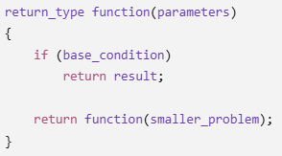
Recursive Thinking for Problem Solving in C
Recursive thinking is a problem-solving technique where a problem is solved by breaking it into smaller versions of the same problem until reaching a simple case that can be solved directly.
In C, recursion is implemented using a function that calls itself.
1) Basic idea
A recursive solution generally has two parts:
Base Case – the condition that stops recursion.
Recursive Case – the function calls itself with a smaller/simpler input.
General structure of Recursion

Slide 149
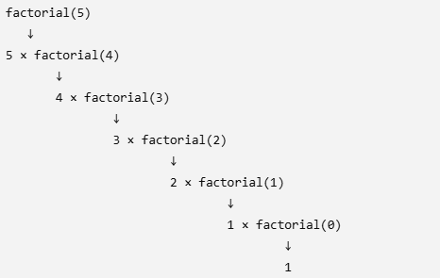
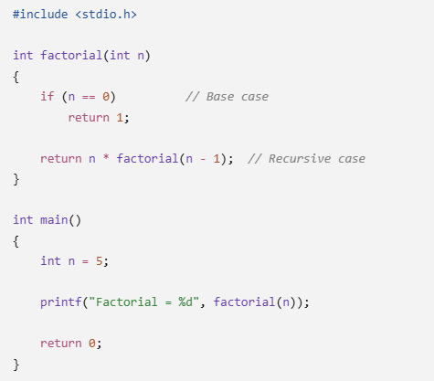
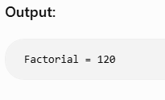
2) Example: Factorial
Mathematically:
$$n!=n×\left(n−1\right)!$$
&
0!=1
How the recursion works:
For factorial(5):
1
Then the results return upward:
factorial(0) = 1
factorial(1) = 1 × 1 = 1
factorial(2) = 2 × 1 = 2
factorial(3) = 3 × 2 = 6
factorial(4) = 4 × 6 = 24
factorial(5) = 5 × 24 = 120

Slide 150
3. How to Think Recursively
When solving a programming problem, ask these questions:
Step 1: Can the problem be divided into a smaller version of itself?
For example:
Find factorial of 5
Instead of solving 5! directly:
5! = 5 × 4!
Now the same problem exists again:
4! = 4 × 3!
Step 2: What is the smallest possible problem?
For factorial:
0! = 1
This becomes the base case.
Step 3: How can I reduce the problem?
For factorial:
n → n - 1
So each recursive call works with a smaller value.
4. Another Example: Sum of Natural Numbers
Problem:
1 + 2 + 3 + 4 + 5
Think:
sum(5) = 5 + sum(4)
sum(4) = 4 + sum(3)
sum(3) = 3 + sum(2)
...

Slide 151
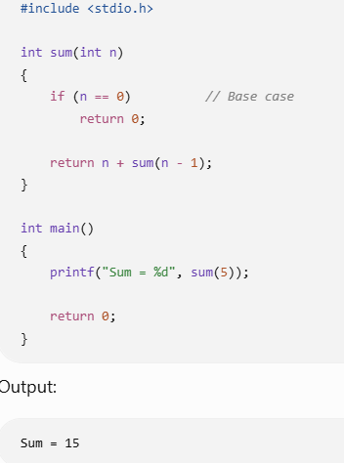
5. Recursion and the Call Stack
Each recursive function call is stored in the stack memory.
For factorial(3):
factorial(3)
↓
factorial(2)
↓
factorial(1)
↓
factorial(0)
When the base case is reached, the functions return in reverse order:
factorial(0) → 1
factorial(1) → 1
factorial(2) → 2
factorial(3) → 6
This is why it is important to have a base case. Without one, recursion can continue indefinitely and eventually cause a stack overflow.

Slide 152
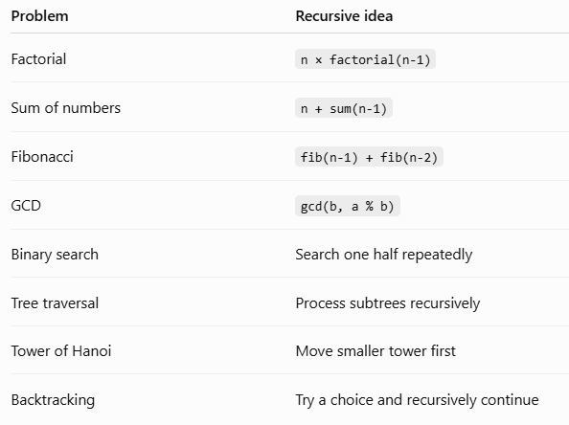
6. Problems Suitable for Recursive Thinking:
Recursion is particularly useful for problems involving:

Slide 153
26CSE1002J - Programming for Problem Solving
Unit 2 (Modularity)
SLO 10 : Design and implement recursive solutions for mathematical and logical problems (such as factorial, Fibonacci, digit counting, and GCD) by breaking them into smaller subproblems and establishing valid recurrence relations.

Slide 154
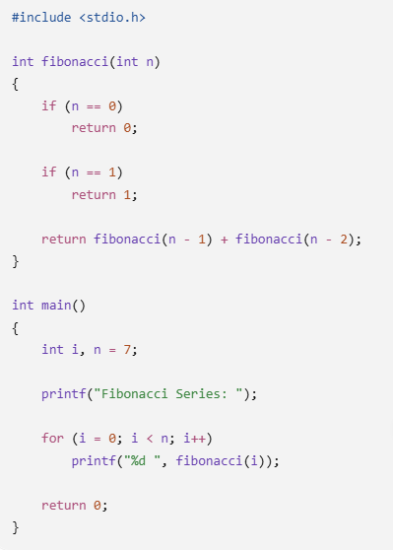
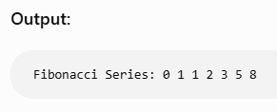
Implementation of Fibonacci Series
The Fibonacci sequence is:0 1 1 2 3 5 8 13 ...
Each number is the sum of the previous two numbers.
F(n)=F(n−1)+F(n−2)
Base cases:
F(0) = 0
F(1) = 1

Slide 155
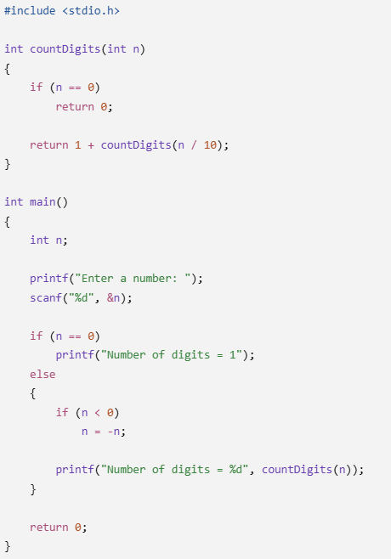

Implementation of Digit counting
To count the number of digits in a number, we can repeatedly divide the number by 10.
There are 5 digits.
Recursive Logic
The relationship is:
$$count\left(n\right)=1+count\left(n/10\right)$$
The base case is:
If n == 0, return 0
How it works: For 12345:
countDigits(12345)
= 1 + countDigits(1234)
= 1 + 1 + countDigits(123)
= 1 + 1 + 1 + countDigits(12)
= 1 + 1 + 1 + 1 + countDigits(1)
= 1 + 1 + 1 + 1 + 1 + countDigits(0)
= 5

Slide 156
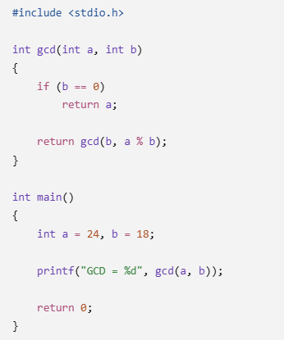

Implementation of Greatest Common Divisor (GCD)
The GCD is the largest number that divides two numbers exactly.
For example:
GCD(24, 18) = 6
We can use Euclid's algorithm:
$$GCD\left(a , b\right)=GCD\left(b , a\%b\right)$$
Base case:
If b = 0, GCD = a

Slide 157
26CSE1002J - Programming for Problem Solving
Unit 2 (Modularity)
SLO 11 & 12: Guided Practice and Practice Problems

Slide 158
Implementation of Digit counting
To count the number of digits in a number, we can repeatedly divide the number by 10.
There are 5 digits.
Recursive Logic
The relationship is:
$$count\left(n\right)=1+count\left(n/10\right)$$
The base case is:
If n == 0, return 0
How it works: For 12345:
countDigits(12345)
= 1 + countDigits(1234)
= 1 + 1 + countDigits(123)
= 1 + 1 + 1 + countDigits(12)
= 1 + 1 + 1 + 1 + countDigits(1)
= 1 + 1 + 1 + 1 + 1 + countDigits(0)
= 5

Slide 159
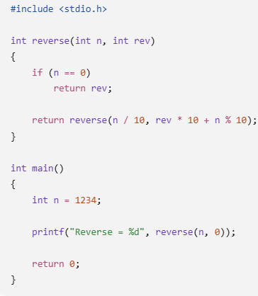
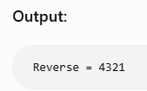
Reverse a Number
This is a simple logical problem that can also be solved recursively.
For example:
1234 → 4321
One approach is to recursively process the digits.

Slide 160
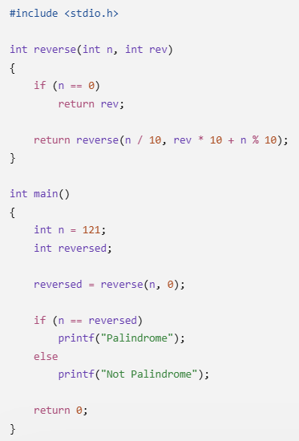
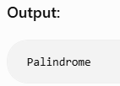
Check Whether a Number is Palindrome
A palindrome reads the same forward and backward.
Examples:
121 → Palindrome
1331 → Palindrome
123 → Not Palindrome
We can recursively reverse the number and compare it with the original.

Slide 161
Implementation of Greatest Common Divisor (GCD)
The GCD is the largest number that divides two numbers exactly.
For example:
GCD(24, 18) = 6
We can use Euclid's algorithm:
$$GCD\left(a , b\right)=GCD\left(b , a\%b\right)$$
Base case:
If b = 0, GCD = a

Slide 162
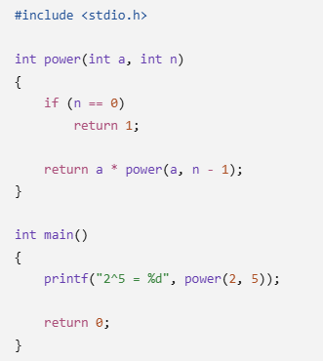
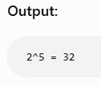
Power of a Number
Calculate:
$$2^{5}=32$$
Recursive relationship:
$$power\left(a , n\right)=a×power\left(a , n−1\right)$$
Base case:
$a^{0}$=1

Slide 163
REFERENCE
[1] B. W. Kernighan and D. M. Ritchie, The C Programming Language, 2nd ed., Prentice Hall, 1988.
[2] E. Balagurusamy, Programming in ANSI C, 8th ed., McGraw Hill Education, 2019.
[3] K. N. King, C Programming: A Modern Approach, 2nd ed., W. W. Norton & Company, 2008.
[4] H. Schildt, C: The Complete Reference, 4th ed., McGraw-Hill Education, 2017.
[5] ISO/IEC 9899:2018, Programming Languages — C, ISO, 2018.

